Slide 1
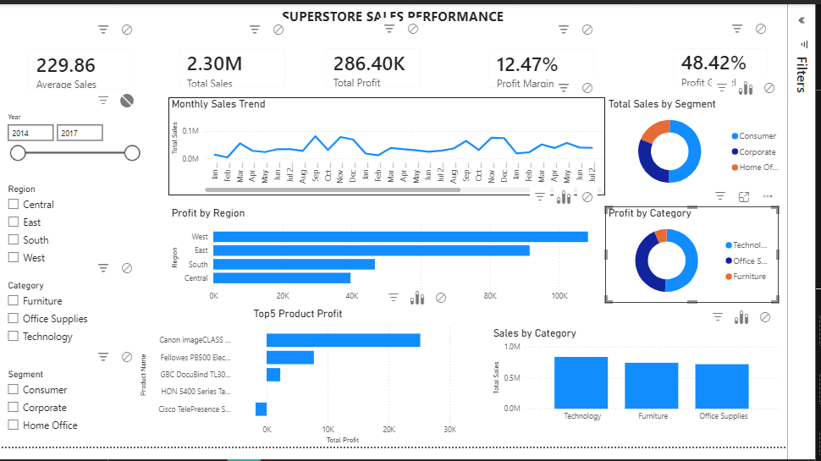
SUPERSTORE SALES PERFORMANCE
AnalystLab Africa — Week 2 Business Intelligence Case Study
Interactive Power BI dashboard for executive sales and profitability monitoring.
Focus: sales performance, profitability, customer segments, products, regions and time trends.
Tools: Microsoft Power BI, Power Query, DAX and interactive visualisation.

Slide 2
1. Business Problem
Management needs a consolidated view of sales, profit, customer segments and regional performance.
The dashboard transforms transactional data into interactive KPIs and visual analysis.
The objective is to identify where revenue is strongest, where profit is strongest, and where management should focus attention.

Slide 3
2. Executive KPI Snapshot
Total Sales: $2.30M
Total Profit: $286.40K
Average Sales: $229.86
Profit Margin: 12.47%
Profit Growth: 48.42% (current dashboard KPI)
Assignment alignment note: Total Orders should be retained/added as the required fifth KPI if not already present.

Slide 4
3. Power BI Dashboard

Slide 5
4. Regional & Customer Performance
West is the strongest region by sales at approximately $725.46K and also leads profit at approximately $108.42K.
Consumer is the largest customer segment, contributing approximately $1.16M in sales.
Regional and segment slicers allow management to investigate performance interactively.

Slide 6
5. Product & Category Performance
Technology is the largest category by sales at approximately $836.15K.
Copiers is the most profitable sub-category at approximately $55.62K.
High sales should be evaluated alongside profit to avoid prioritising low-margin growth.
Top-product analysis supports product-mix and merchandising decisions.

Slide 7
6. Sales Trend
The monthly sales trend shows an overall upward pattern from 2014 to 2017.
The series also displays recurring seasonal variation.
Management can use these patterns for inventory, promotional and staffing planning.

Slide 8
7. Risks & Opportunities
RISKS
• Revenue may mask low-margin or loss-making products.
• Strong sales regions/categories may not always produce the strongest margins.
• Concentration in leading regions or segments can increase exposure to market changes.
OPPORTUNITIES
• Scale high-profit regions and product areas.
• Tailor customer-segment promotions and upselling.
• Use seasonality for operational planning.

Slide 9
8. Management Recommendations
1. Protect and scale the West region while monitoring profitability.
2. Investigate high-sales/low-profit combinations through discount, pricing and product-mix analysis.
3. Prioritise high-margin sub-categories such as Copiers.
4. Review loss-making products before pursuing additional sales volume.
5. Use monthly seasonality to plan inventory, promotions and staffing.

Slide 10
9. Key Takeaway & Learning
The dashboard turns transactional data into a decision-support tool.
The strongest lesson from Week 2 is that BI is not only about charts — it is about connecting metrics to business questions.
Skills developed: Power Query, data modelling, DAX measures, KPI design, interactive slicers, visualisation and business storytelling.
Next improvement: complete the required matrix/map and ensure Total Orders is included without overcrowding the executive page.

